Slide 1

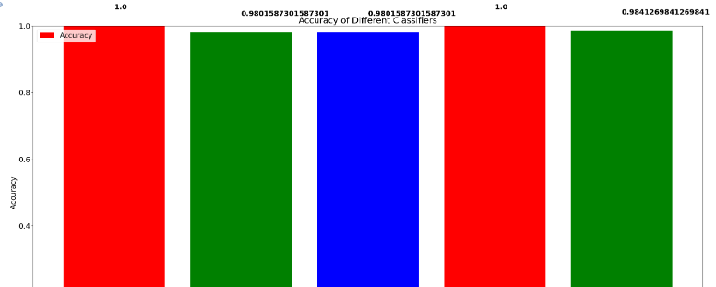
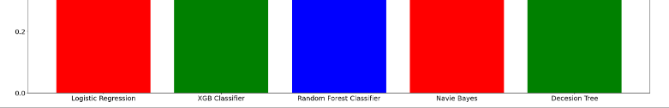
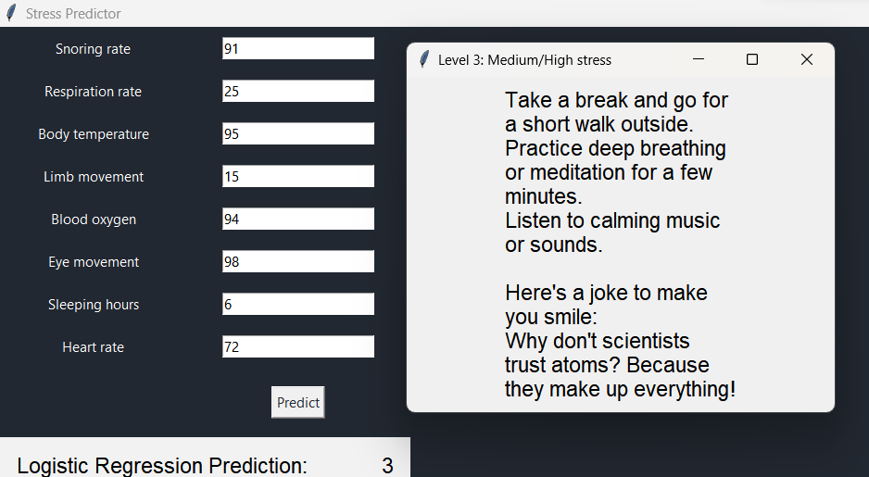
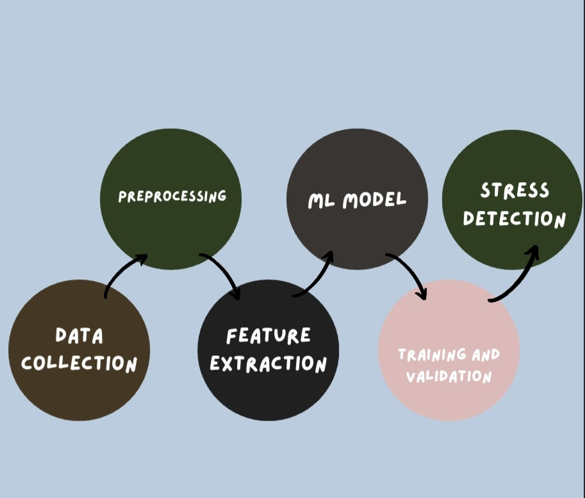
Human stress detection
Human stress detection
Team Members
20MIA1031 - SANJAY.M
20MIA1039- SRIGANTH R
20MIA1106- MADHU KIRAN P
20MIA1117- PILLARAM MANOJ
20MIA1162 - GUNA SHANKAR.S
Dr. SAJIDHA S A (Associate Professor)
School of Computer Science and Engineering
INDUSTRY CONCLAVE 2023
INTRODUCTION
Stress is a common problem that can cause physical and mental health issues such as anxiety, depression, and cardiovascular disease. It can be caused by various factors such as work difficulties, financial problems, marital issues, and health problems. Non-intrusive stress detection tools could be used to provide effective and affordable stress reduction interventions. Everyone has their own unique way of dealing with stress, but too much stress can lead to unfavorable outcomes such as depression and even suicide. Stress can also cause socioeconomic problems, strained professional relationships, and lack of trust in the workplace.
Objectives
The main objective of human stress detection with machine learning is to create a system that can properly recognise and categorise stress in people.
This includes using datasets of wearable technology related to stress to train a machine learning model to identify patterns that are suggestive of stress.
The algorithm can then be applied to categorise fresh signals as stress- or non-stress-related in real-time utilising wearable technology or sensors.
SCOPE of the project
Identifying and selecting appropriate physiological and behavioural signals associated with stress.
Collecting and preprocessing datasets of stress-related signals from various sources, such as wearable devices or sensors.
Creating and training machine learning models with various algorithms and techniques, such as supervised and unsupervised learning.
Using several performance metrics, like as accuracy, precision, and recall, to measure the models' performance.
methodology
Collect physiological signals using wearable devices and sensors such as EEG, EOG, EMG, heart rate, respiration, and movement.
Preprocess the data by reducing noise and artefacts and segmenting the data into distinct time periods or epochs.
Extract pertinent features such as frequency content, amplitude, and variability from the preprocessed data using signal processing techniques.
Develop a machine learning model using the extracted features and a labelled dataset that contains examples of both stressed and non-stressed states.
Train and validate the machine learning model using a subset of the labelled dataset for training and the remaining subset for validation to assess accuracy and generalization performance.
Apply the trained model to fresh, unexplored data to predict stress state based on the extracted features.
Use the results of stress detection to develop stress management solutions such as meditation, cognitive behavioural therapy, or medication
Architecture
Have the system architecture diagram/process block diagram here.
Briefly describe the diagram here.
Results and discussion
Conclusion
Logistic regression, XGB classifier, random forest classifier, navie bayes, and decision tree algorithms can be used to predict human stress.
The accuracy comparison of the five algorithms shows logistic regression and navie bayes have 100% accuracy, while the decision tree works relatively fine with an accuracy of 98.41%.
Inputs from the user are used to predict stress levels, with four levels increasing by 25%.
Machine learning systems can effectively anticipate stress levels, helping identify variables that create stress in humans.
Findings may be valuable to scholars and healthcare practitioners investigating stress-related disorders in humans.
References
https://www.ijeat.org/wp-content/uploads/papers/v9i1/F8573088619.pdf
https://www.irejournals.com/formatedpaper/1702649.pdf

